Slide 1

Customer Shopping Behavior Analysis
Uncovering insights from 3,900 purchases to drive strategic decisions

Slide 2

OVERVIEW
Project Scope
Analysis Goals
Spending patterns across demographics
Customer segmentation insights
Product preferences by category
Subscription behavior trends

Slide 3
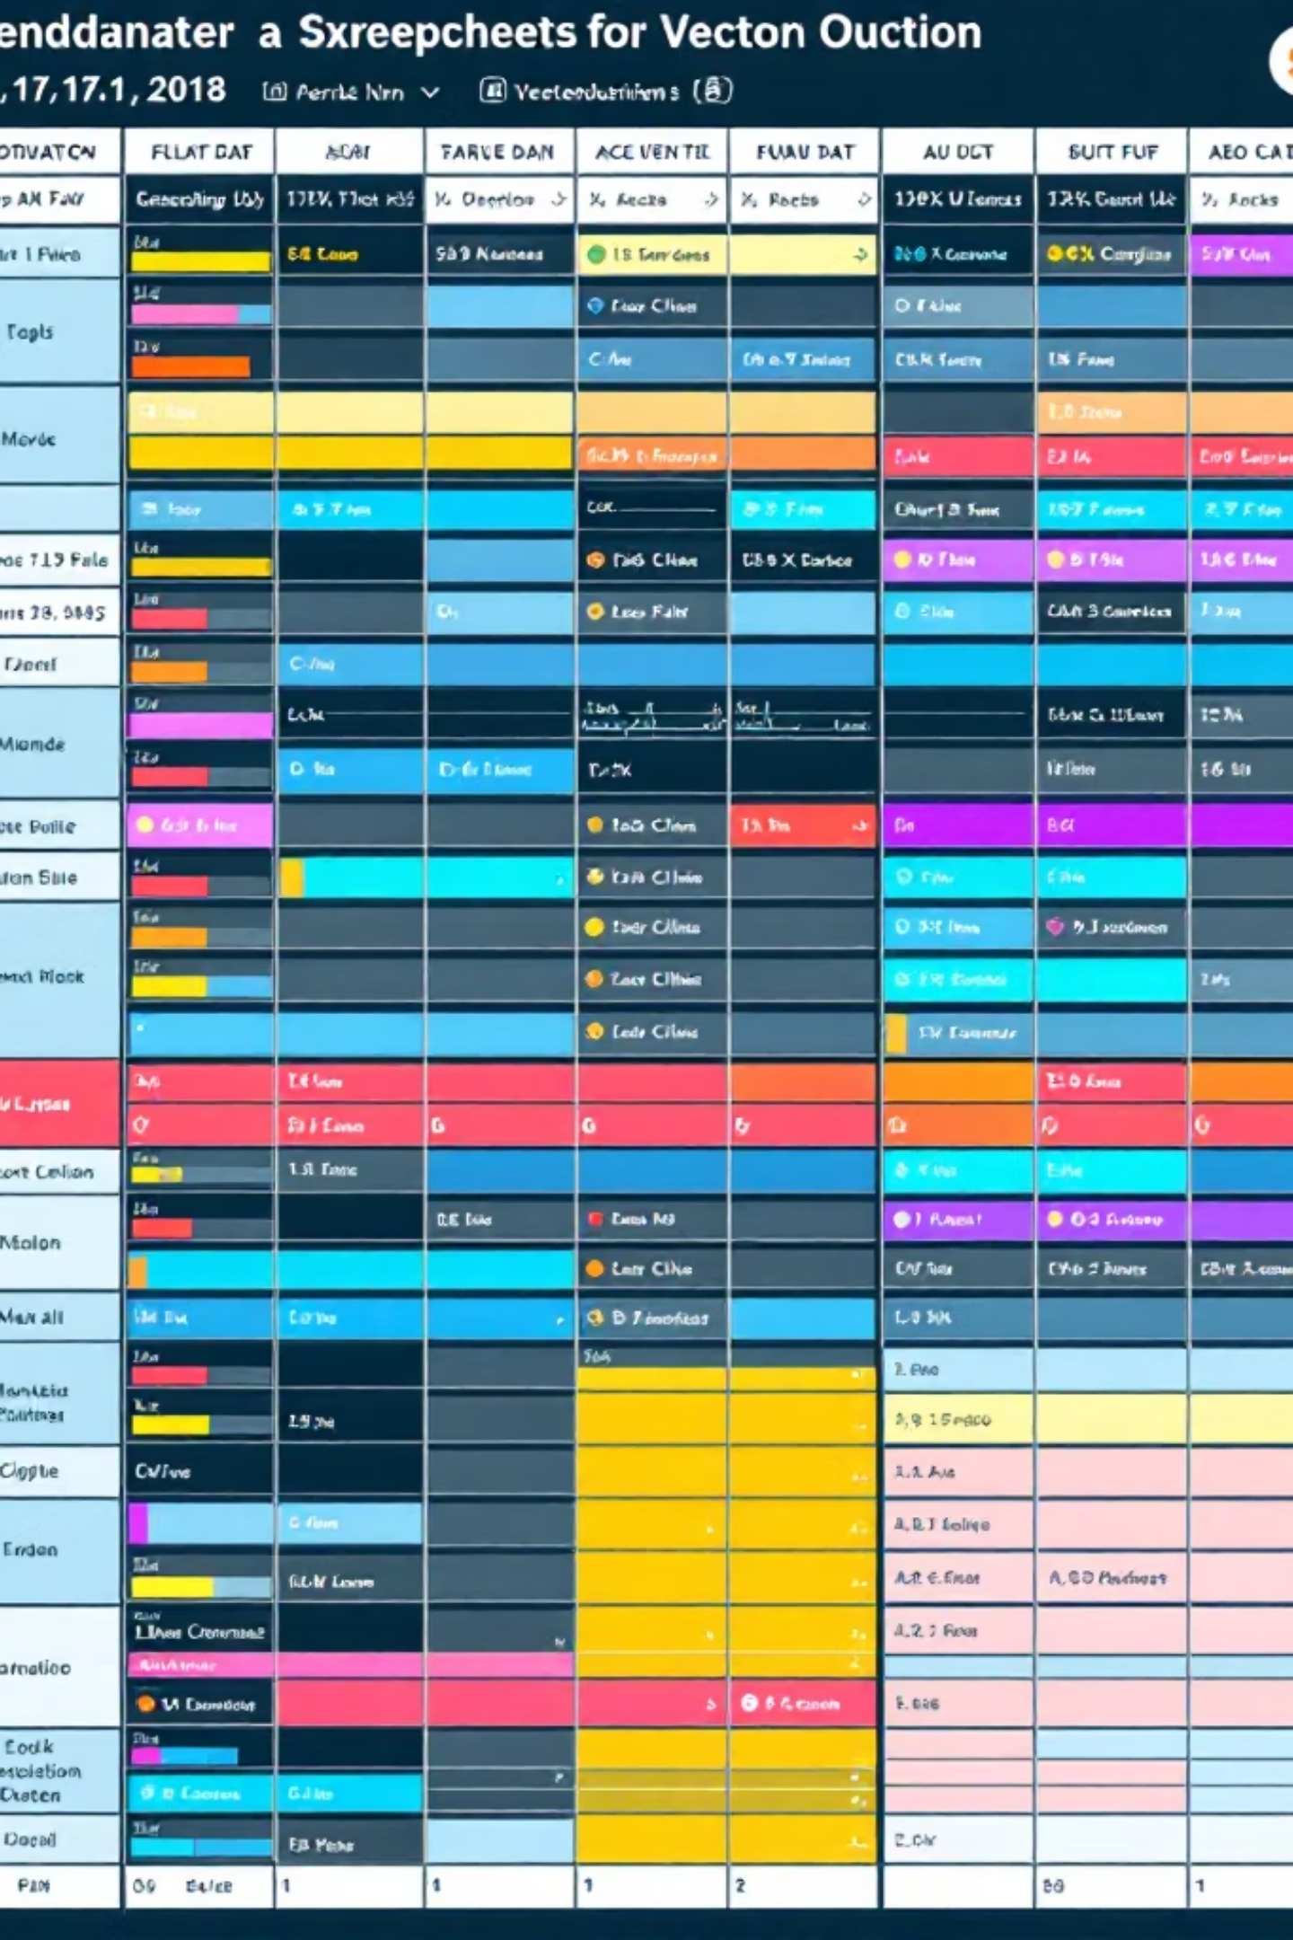
DATA FOUNDATION
Dataset Overview
3,900
18
50
Total Purchases
Data Points
Locations
Transactions analyzed
Features per transaction
Geographic coverage
4
Categories
Product segments

Slide 4

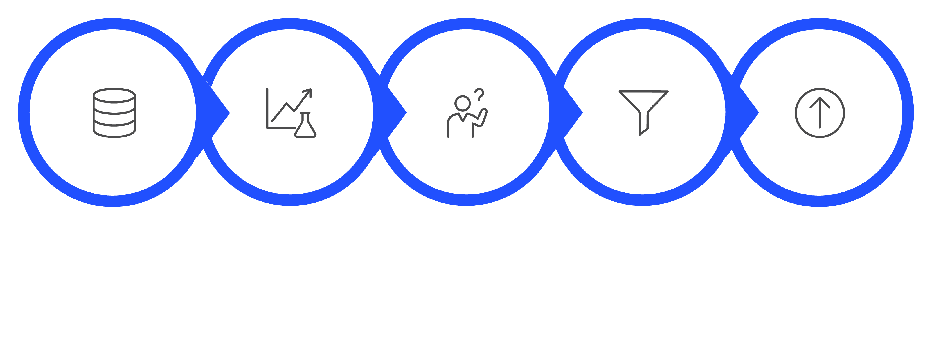
PYTHON
Data Preparation Process
Explore & Clean
Handle Missing Values
Engineer Features
Export to Database
Load Data
Cleaned and standardized dataset with feature engineering for deeper analysis

Slide 5
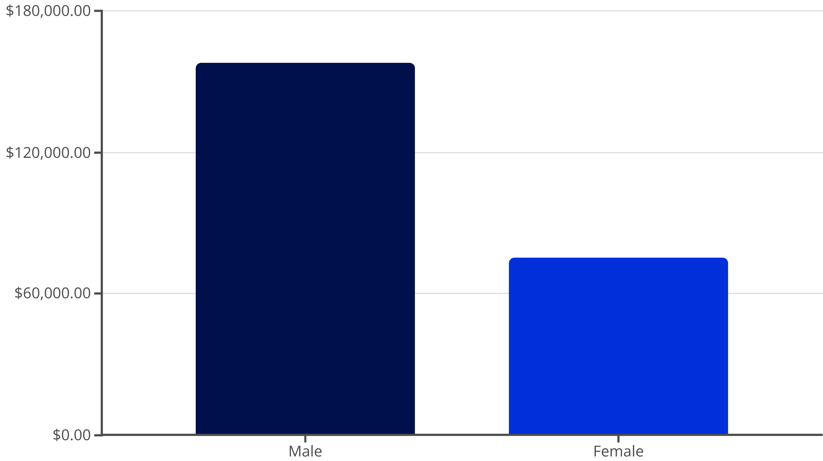
KEY INSIGHTS
Revenue Analysis
Gender Revenue Gap
Male customers generate 2.1x more revenue than female customers
Strategic Opportunity: Develop targeted campaigns to increase female customer engagement and spending

Slide 6



Top-Rated Products
3.86
Gloves
Highest rated item
3.84
Sandals
Strong customer satisfaction
3.82
Boots
Consistent quality
3.80
Hat
Popular accessory

Slide 7

CUSTOMER SEGMENTS
Loyalty Distribution
Customer Classification
Based on purchase history and behavior patterns
Loyal
3,116 customers
80% of base
Returning
701 customers
18% of base
New
83 customers
2% of base

Slide 8

Subscription Impact
Subscription Opportunity
Only 27% of customers are subscribers
Average Spend:
Subscribers: $59.49
Non-subscribers: $59.87
Similar spending patterns suggest untapped subscription potential
Non-Subscribers
Subscribers

Slide 9
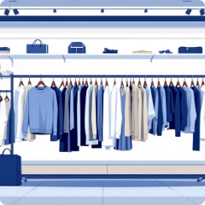


DASHBOARD
Power BI Insights
Clothing Dominates
Young Adults Lead
Shipping Preferences
$100K revenue, 1,800 sales
Highest revenue and sales volume
Express users spend $2 more on average

Slide 10
ACTION PLAN
Strategic Recommendations
Boost Subscriptions
Loyalty Programs
Promote exclusive benefits to convert 73% non-subscribers
Reward repeat buyers to strengthen 80% loyal segment
Discount Strategy
Targeted Marketing
Balance promotions with margin control across categories
Focus on high-revenue age groups and express shipping users

